Slide 1
Machine Learning
Unit-5

Slide 2
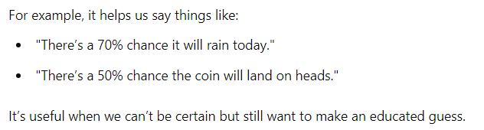
Probabilistic model
A probabilistic model is like a tool that helps us understand and predict things when we're not sure what will happen.

Slide 3
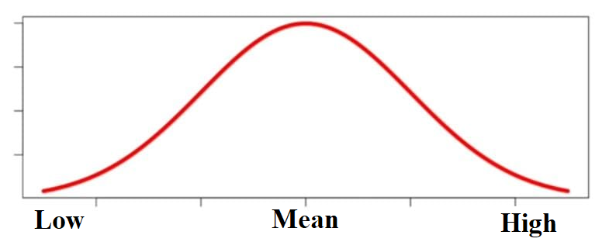
Normal Distribution and its Geometric Interpretations
What is Normal Distribution?
Imagine a bell-shaped curve. Most of the data points are around the middle (the highest point), and fewer data points are far from the middle (the curve gets lower on both sides).
The middle of the curve is called the mean (average).

Slide 4
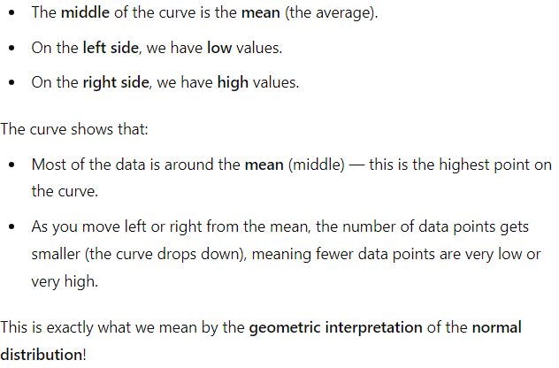
Geometric interpretation of the normal distribution:-

Slide 5
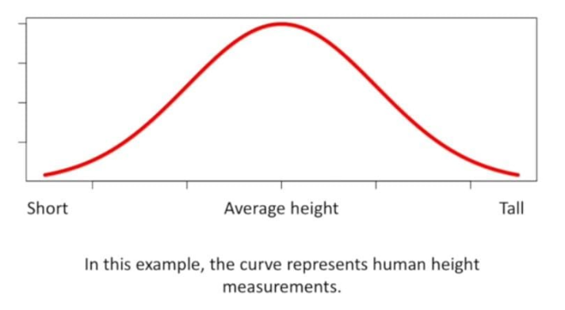
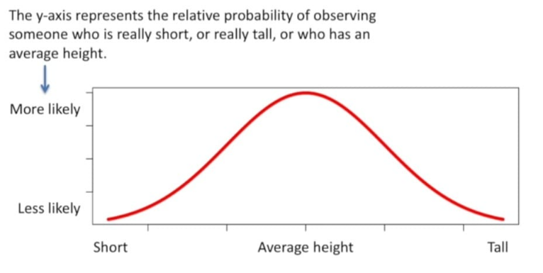
Example of Normal Distribution and its Geometric Interpretations:-

Slide 6
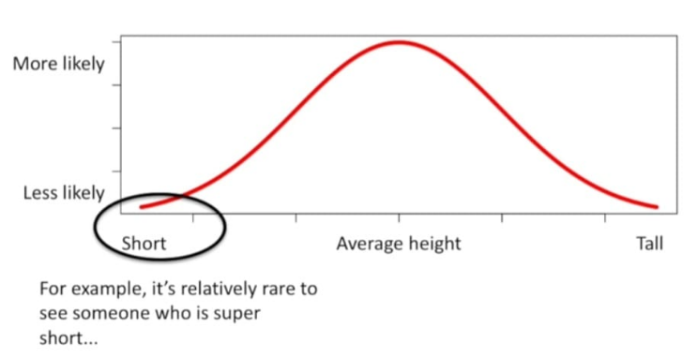
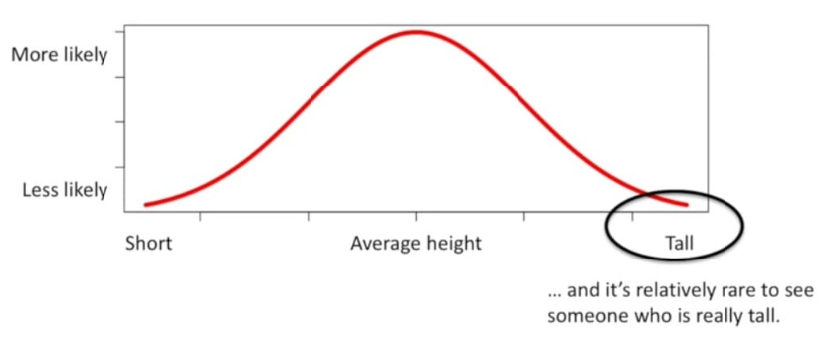
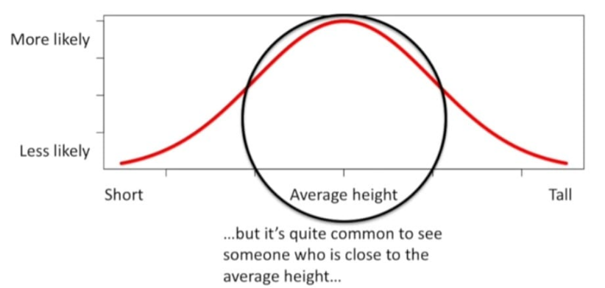

Slide 7
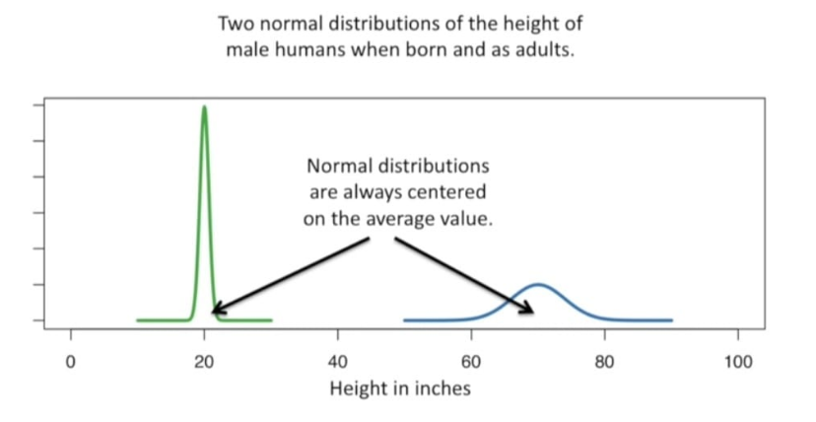

Slide 8
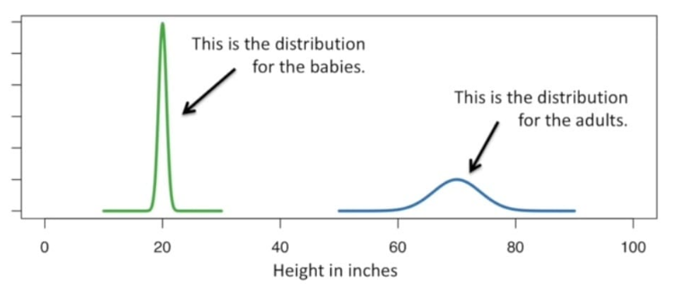
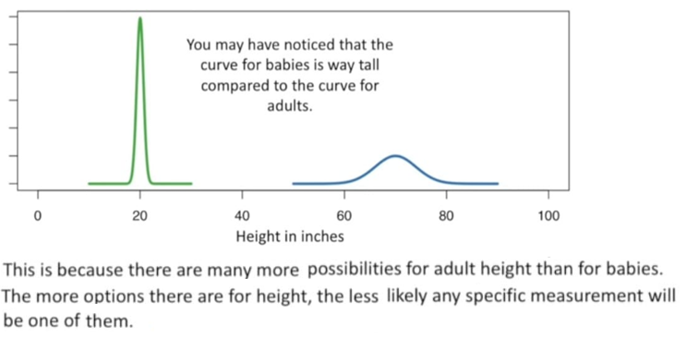

Slide 9
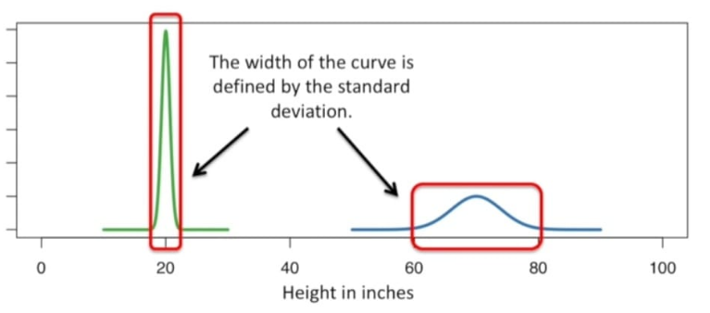
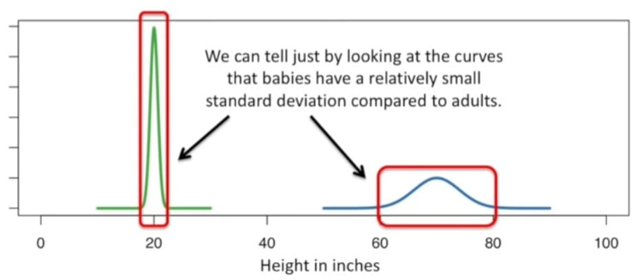
If most values in the dataset are very similar or close to each other, the standard deviation will be small.
For example, if the scores of a class are all between 85 and 90, the standard deviation will be low because the scores are close to the mean.

Slide 10
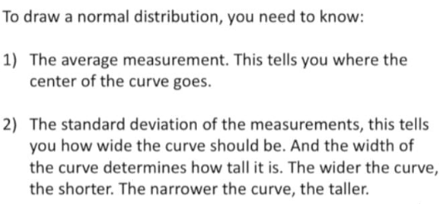

Slide 11
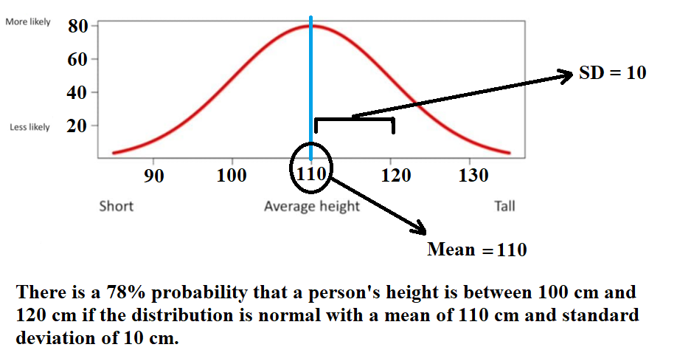
For example:-

Slide 12
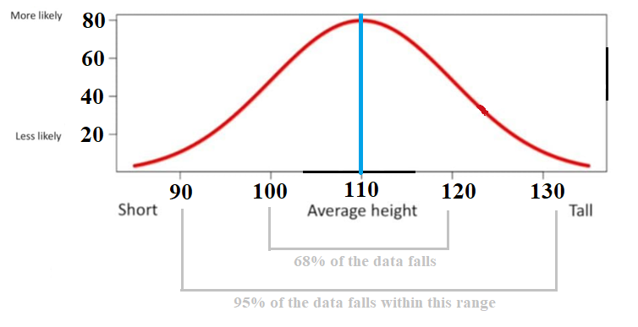
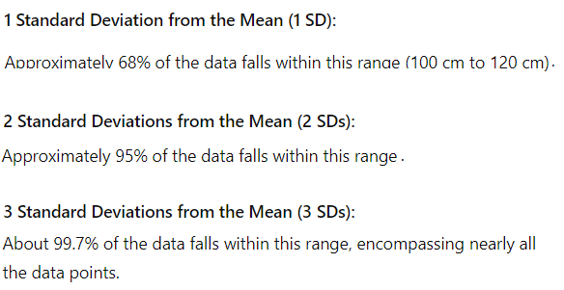
Note:-

Slide 13
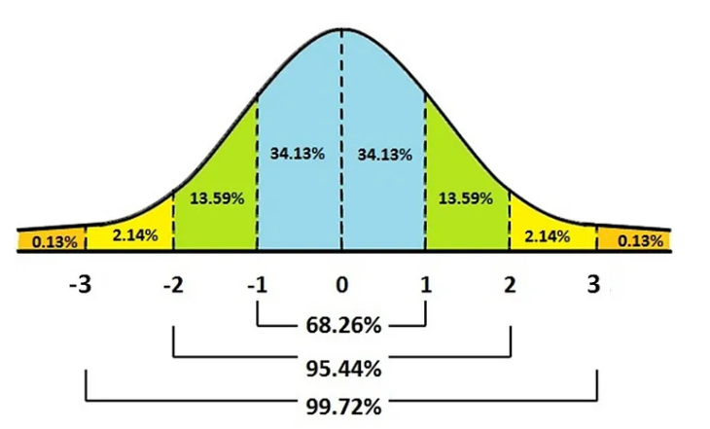

Slide 14
How normal distribution is linked to probabilistic model:-
Many things in real life, like heights or test scores, often follow a normal distribution.
For example:-
Height: Most people's heights are close to the average height, with fewer people being very short or very tall.
Test Scores: In a large group of students taking the same exam, most scores will cluster around the average, with fewer students scoring very low or very high.
Many machine learning models perform better when the data is normally distributed. It helps meet the assumptions of the models.
Normal distribution is flexible and can fit many types of data, which is why it's often used.

Slide 15
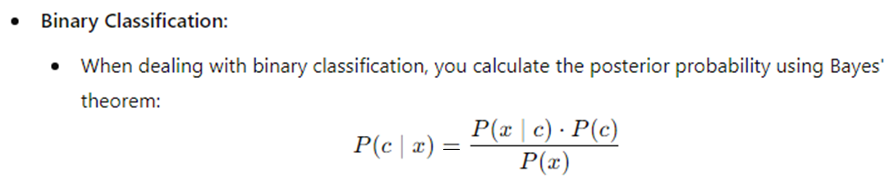
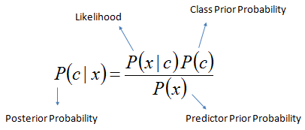
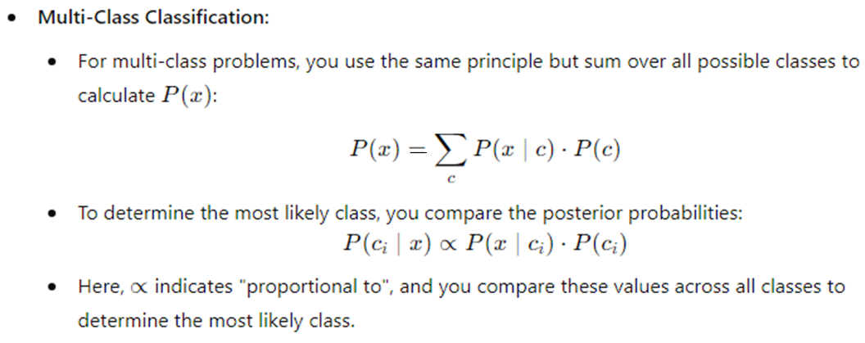
Naïve Bytes Classifier

Slide 16
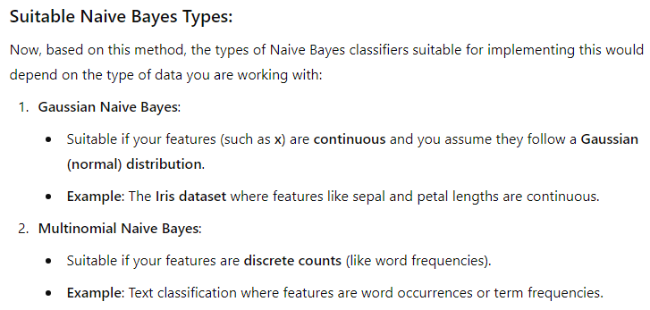
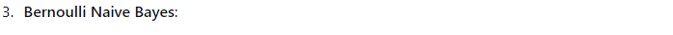
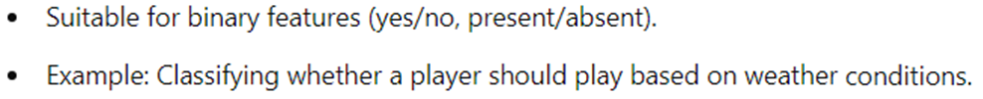

Slide 17
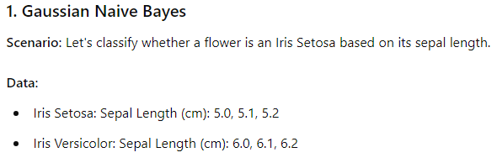
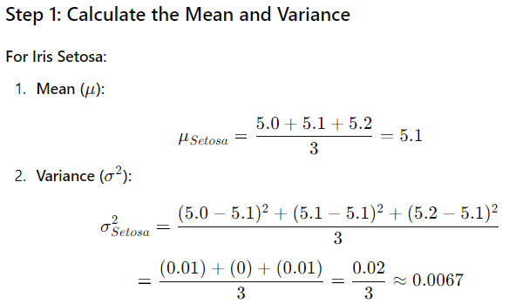
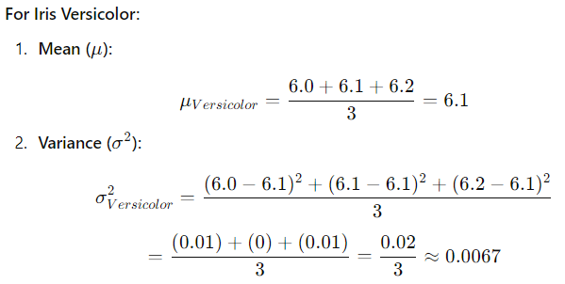
Examples:-

Slide 18
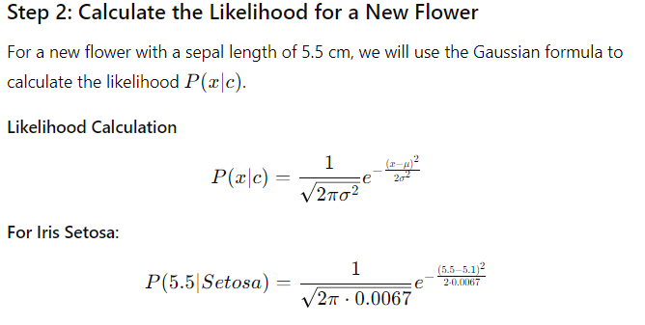
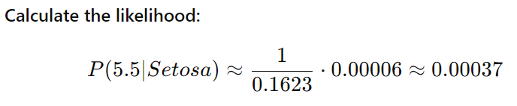

Slide 19
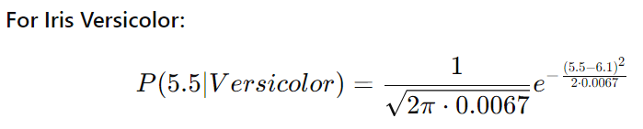
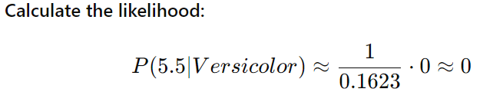
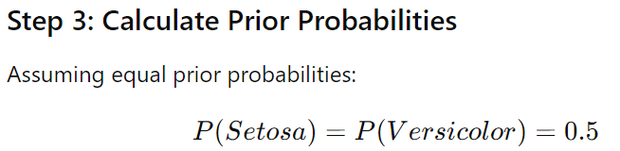

Slide 20
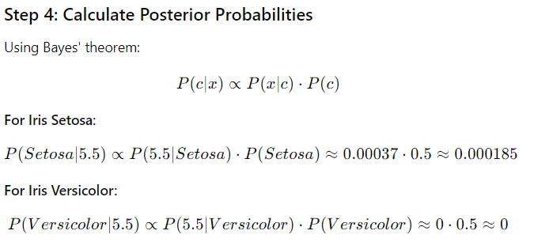
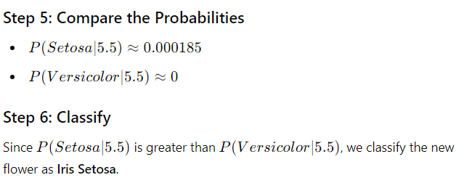
Refer 3-A Practical of Machine learning for more. In 3-A, I have used Gaussian Naive Bayes.

Slide 21
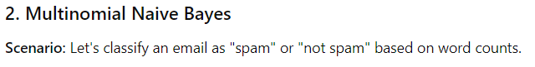
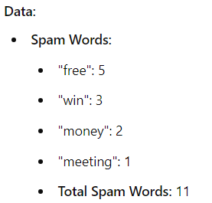
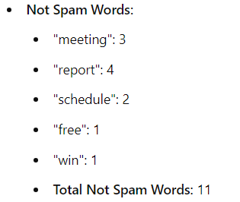

Slide 22
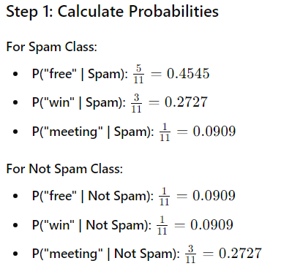

Slide 23
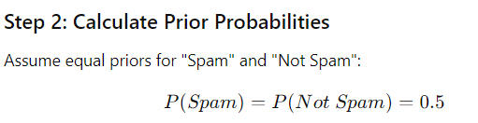
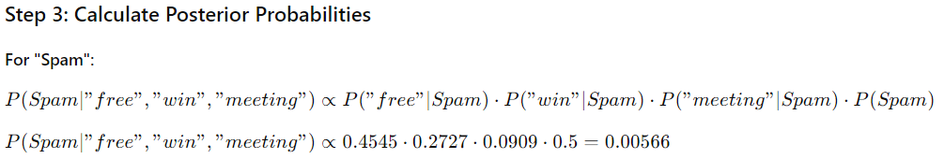

Slide 24
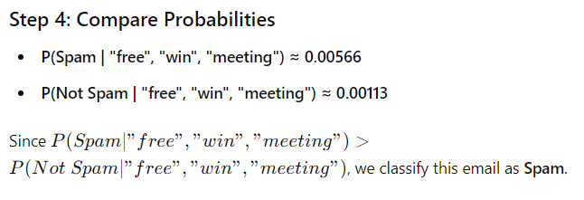

Slide 25
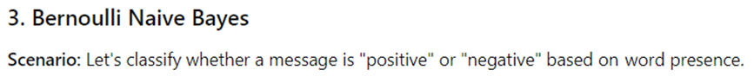
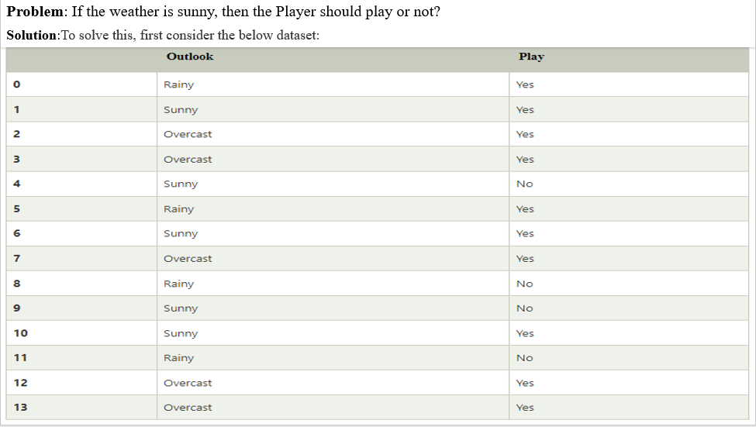

Slide 26
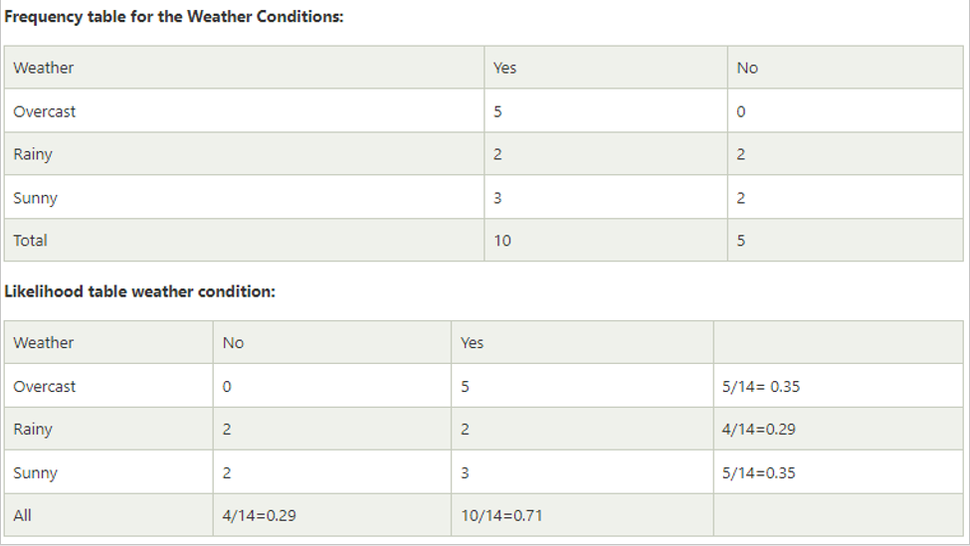

Slide 27
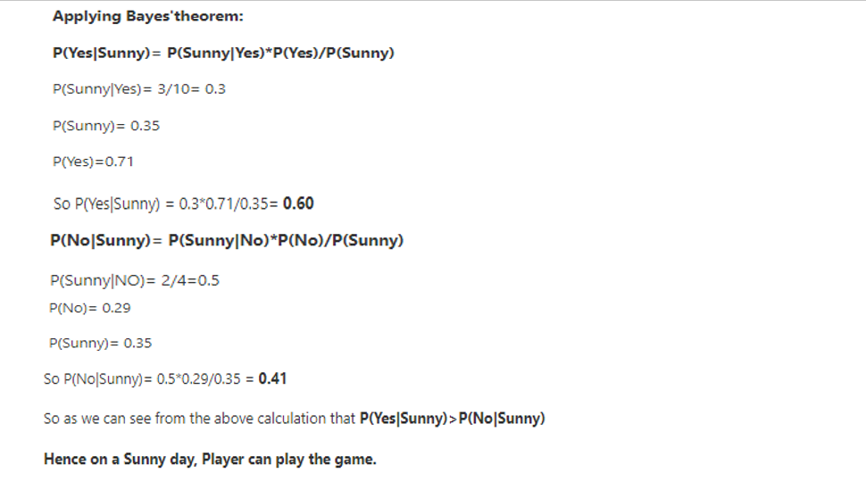

Slide 28
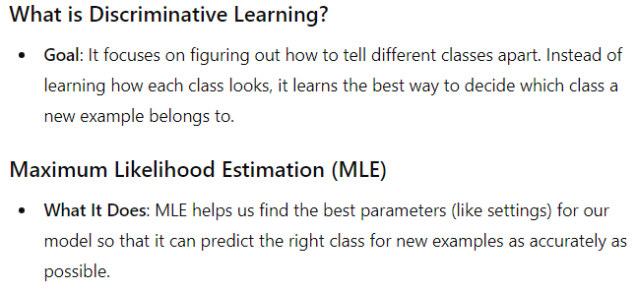
Discriminative learning with maximum likelihood.

Slide 29
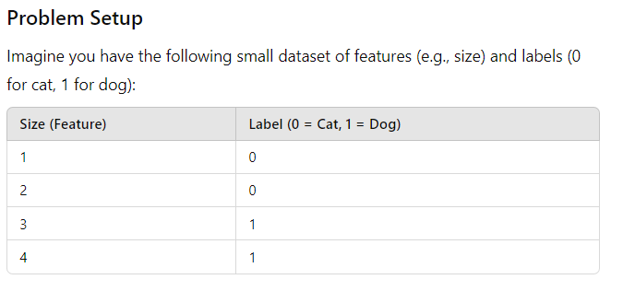
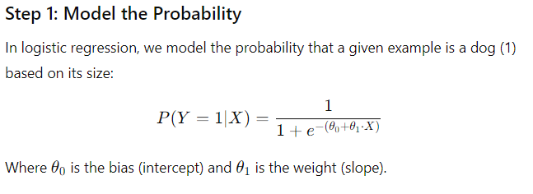

Slide 30
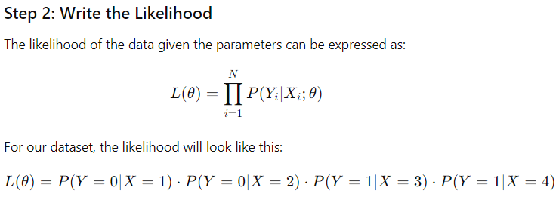
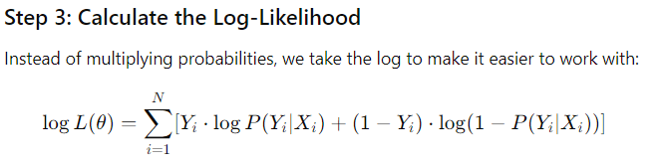

Slide 31



Slide 32


To improve the model, you should adjust the parameters through optimization techniques (like gradient ascent) to maximize the log-likelihood. This process aims to bring the log-likelihood closer to zero or higher, improving the model's predictions.

Slide 33

Note:- Discriminative learning with maximum likelihood is a broader concept applicable to many models beyond logistic regression. It encompasses any approach that learns to distinguish between classes by modeling the conditional probabilities, using maximum likelihood to estimate the parameters of those models.

Slide 34

Probabilistic model with hidden variables
A Probabilistic Model with Hidden Variables is a model used to understand data where some information is missing or hidden. It tries to guess the hidden information by looking at the data we can see and using probabilities.
Key Idea:
Observed Data: This is the information we can see and measure.
Hidden Variables: These are things that we can’t see directly but still affect the data.

Slide 35


Estimation-Maximization Methods
Note:
You can refer to it as either "Estimation-Maximization" or "Expectation-Maximization." Both terms describe the same algorithm and process for estimating parameters in probabilistic models with hidden variables.

Slide 36




Slide 37



Slide 38





Slide 39


Pictorial Representation:-

Slide 40


Flowchart:-

Slide 41


Gaussian Mixtures

Slide 42



Slide 43



Slide 44



Slide 45



Slide 46



Slide 47



Slide 48


Slide 49




Slide 50


Slide 51


Compression-Based Models

Slide 52



Slide 53

By using a compressed-based model, you effectively focused on the relevant data (heights) and removed unnecessary information (roll numbers). This streamlined the process and allowed you to apply clustering methods like EM more efficiently!

Slide 54

Importance of Compression-Based Models
The compressed-based model is also linked to probabilistic models with hidden variables. Since we won't always be working with every feature of a large dataset, this approach ensures that we focus on the most relevant information, making the process more efficient.

Slide 55


Trends in Machine Learning
Models and symbols bagging and boosting:-
Bagging:

Slide 56


Slide 57



Slide 58


In the context of our example, when predicting prices for different subsets of data—such as houses with 3 rooms, 2 rooms, and 1 room—the 5 models are being applied simultaneously to each subset.
After getting the predictions from all models for each room type, you can aggregate the results (typically by averaging) to come up with a final predicted price for each subset.

Slide 59



Slide 60


Slide 61

Boosting:

Slide 62



Slide 63



Slide 64




Slide 65

Bagging vs Boosting

Slide 66
Multitask Learning
Multi-Task Learning (MTL) is a technique where a model is trained to perform multiple tasks at once. Instead of creating separate models for each task, MTL allows a single model to share knowledge across different tasks. This can lead to better performance, especially when the tasks are related.
Here are a few examples of Multi-Task Learning (MTL) in action:
Natural Language Processing (NLP)
Task: Sentiment Analysis and Emotion Detection
Description: A single model can be trained to classify the sentiment of a text (positive, negative, neutral) while also detecting specific emotions (e.g., joy, anger, sadness). By sharing a common feature extractor that understands language structure, the model can improve its performance on both tasks.
Computer Vision
Task: Gender detection and age detection Description
Description: In a multi-task learning model for computer vision, both gender detection and age detection are performed simultaneously. The model uses a shared network to learn common facial features, then has separate parts to predict gender (male or female) and estimate age. This method boosts accuracy, saves training time, and helps avoid overfitting, making it useful for social media and retail.
User Behavior Prediction and Recommendation
Task: Predict user behavior and recommend products.
Description: A model predicts how users will behave online while suggesting products, improving personalization by learning from both tasks.

Slide 67
Speech Recognition
Task: Speech Transcription and Speaker Identification
Description: A model can be trained to convert spoken language into text while also identifying who is speaking. By learning shared audio features, the model can become more adept at distinguishing different speakers and accurately transcribing speech.
Autonomous Vehicles
Task: Object Detection and Lane Detection
Description: An autonomous driving system can detect pedestrians, vehicles, and traffic signs while also recognizing lane boundaries. By sharing features learned from the environment, the model enhances its ability to navigate safely and effectively.
Healthcare
Task: Disease Diagnosis and Risk Prediction
Description: A deep learning model can analyze medical images (like X-rays) to diagnose diseases and simultaneously predict the risk of future complications. Sharing knowledge about image features helps improve the accuracy of both tasks.
Speech Recognition and Emotion Detection
Task: Transcribe spoken language and identify emotions.
Description: A model processes audio to convert speech into text and detect emotions, enhancing understanding of context by learning from both tasks.
Image Captioning and Object Detection
Task: Generate descriptive captions and identify objects.
Description: A model creates captions for images while detecting objects within them, improving the accuracy of descriptions through shared features.

Slide 68


Online Learning and Sequence Prediction

Slide 69


Another Example: Product Recommendations

Slide 70


Slide 71



Data streams and active learning

Slide 72


Slide 73



Slide 74


For example:

Slide 75


Slide 76


Slide 77

Deep Learning

Slide 78


Slide 79


Slide 80

Reinforcement Learning

Slide 81


Slide 82


